Slide 1
Laser Light Show
ELEC 391 – Group B1

Slide 2
Simulink Model

Slide 3
RCGs
Requirements
Usable PID Values Obtained
Encoder Detects All Pulses
Constraints
Control Frequency of 1000 Hz
Max Motor Current ( < 2A )
Goals
Rise Time ( < 0.017 s )
Overshoot ( < 10 % )
No Breadboards
Max Encoder Resolution ( 400 pulses )
Simulink Model of Motor Within 5 % Error
Support shapes with >5 vertices

Slide 4
The Process
Find Motor Parameters
System Modeling
Control

Slide 5
Motor Parameters
R, L (8.4 $Ω$ , 1.12mH)
R, L (8.4 Ω , 1.12mH)
Measured using multimeter
$Kτ$ ( 23.54 $\frac{mNm}{A}$ )
Kτ ( 23.54 mNm/A )
J ( $5.93×{10}^{−6}$ $kg m^{2}$ )
J ( 5.93×〖10〗^(−6) kg m^2 )
B ( 4.964 $×{10}^{−6}$ $\frac{kg m^{2}}{s}$ )
B ( 4.964 ×〖10〗^(−6) (kg m^2)/s )
Torque determined from conservation of power
Calculated from mechanical time constant
Kv ( 628.5 $\frac{RPM}{V}$ )
Kv ( 628.5 RPM/V )
Back EMF calculated from KVL
Kinetic friction from $\frac{torque}{speed}$ at no load conditions
Kinetic friction from 𝑡𝑜𝑟𝑞𝑢𝑒/𝑠𝑝𝑒𝑒𝑑 at no load conditions
Resistance and Impedance
Torque Constant
Rotor Inertia
Back EMF
Kinetic Friction

Slide 6

Checking Motor Parameters

Slide 7
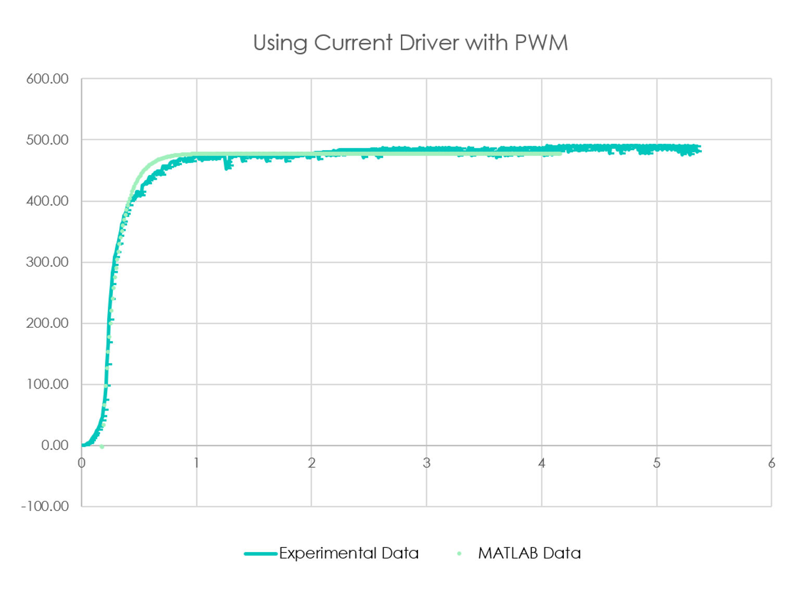
Checking Motor Parameters

Slide 8
Motor Model Roots
* not to scale *
-7493
-8
0

Slide 9
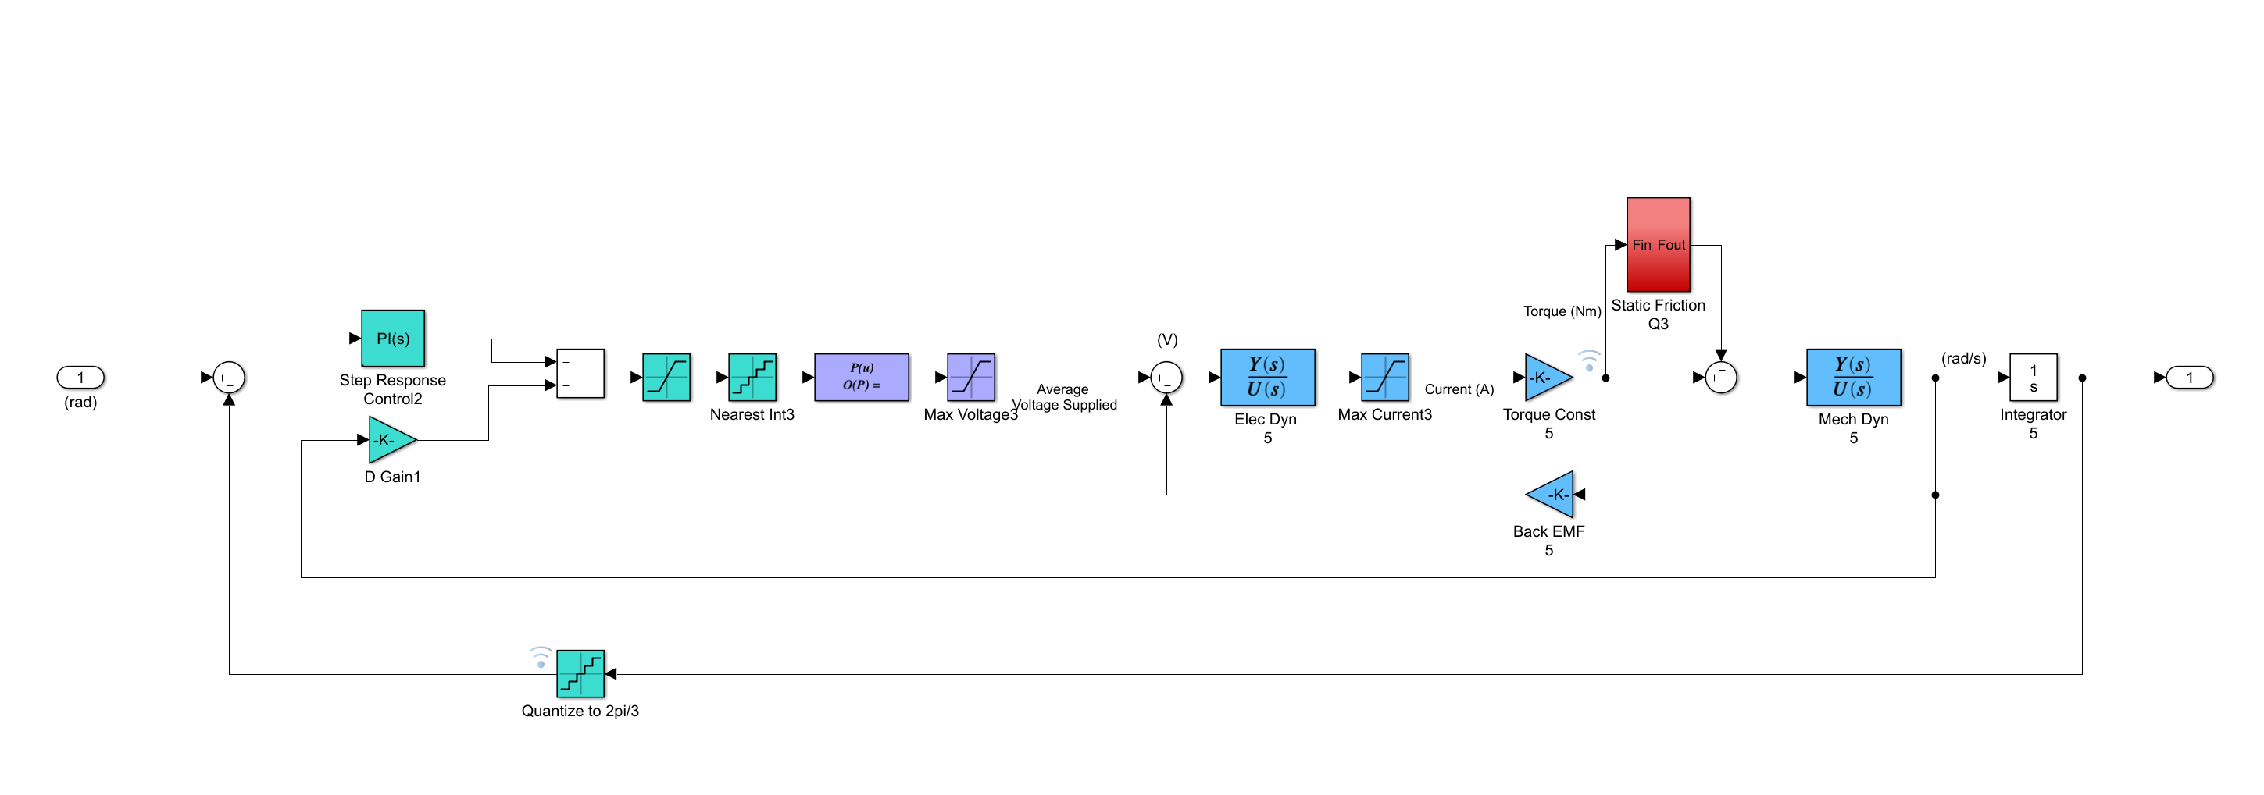
Simulink Model with PID Control
Static Friction and Cogging
PWM Value between
0 - 255
Maps PWM to Average Voltage
Output Position
Input Step
Derivative Gain on Velocity
Quantizes Angle to Encoder Resolution
Motor Transfer Function

Slide 10
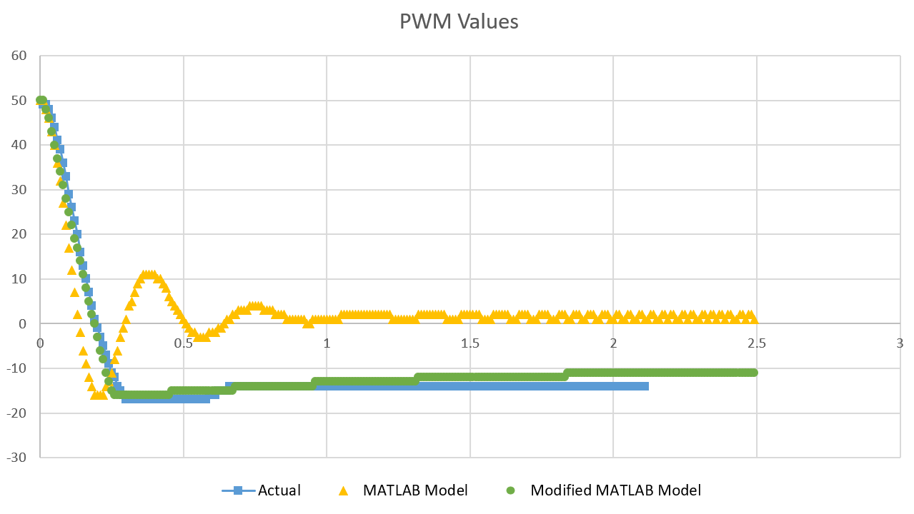
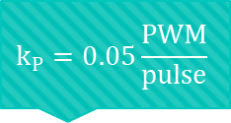
P Control
$$k_{P}=0.05\frac{PWM}{pulse}$$

Slide 11
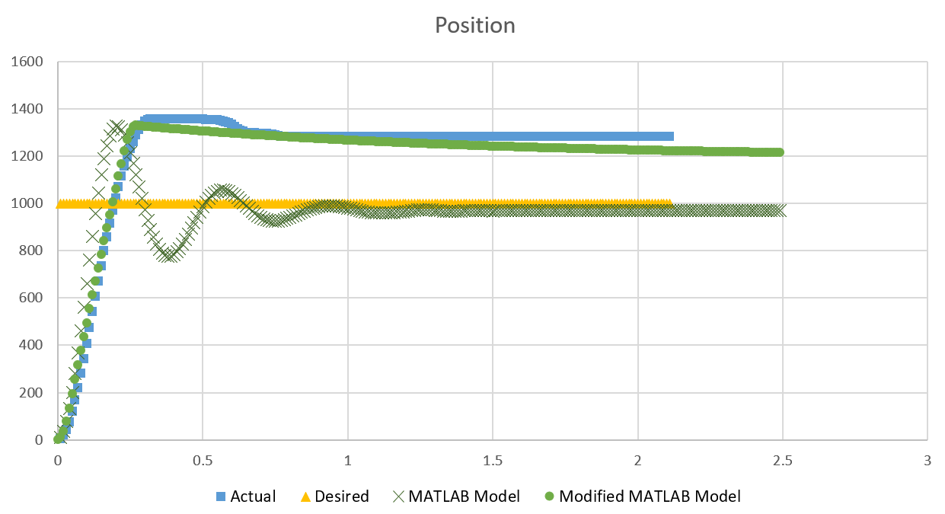
P Control

Slide 12
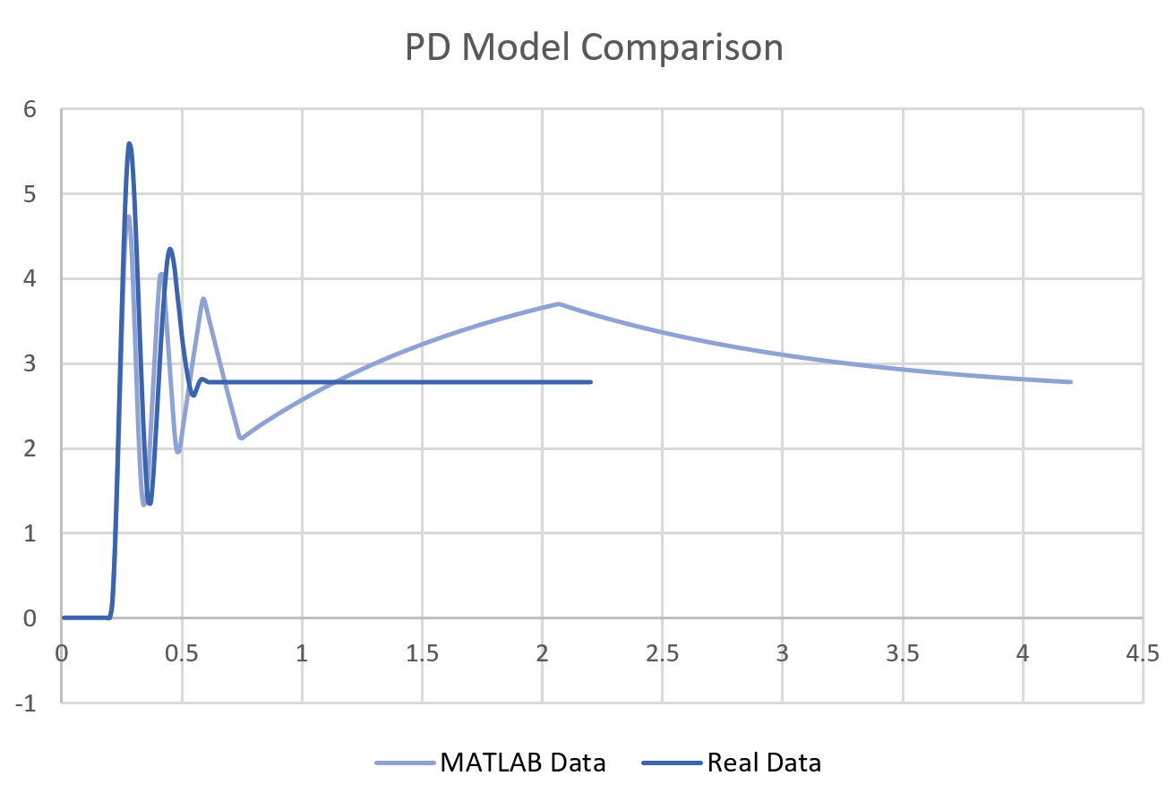
PD Control

Slide 13
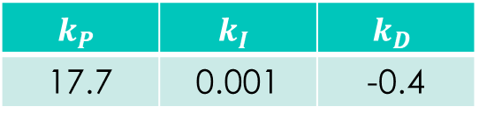
Initial Control
Aim for fastest rise time and small overshoot
Ensure system is stable
Overshoot | 14.28 %
Rise Time | 0.1 s
Settle Time | 2 s
$$k_{P}$$ | $$k_{I}$$ | $$k_{D}$$
17.7 | 0.001 | -0.4

Slide 14
Performance (Pitch)
Overshoot | ~ 2 %
Rise Time | ~ 0.13 s
Settle Time | ~ 0.12 s

Slide 15
Performance (Yaw)
Overshoot | ~ 5 %
Rise Time | ~ 0.13 s
Settle Time | ~ 0.3 s

Slide 16

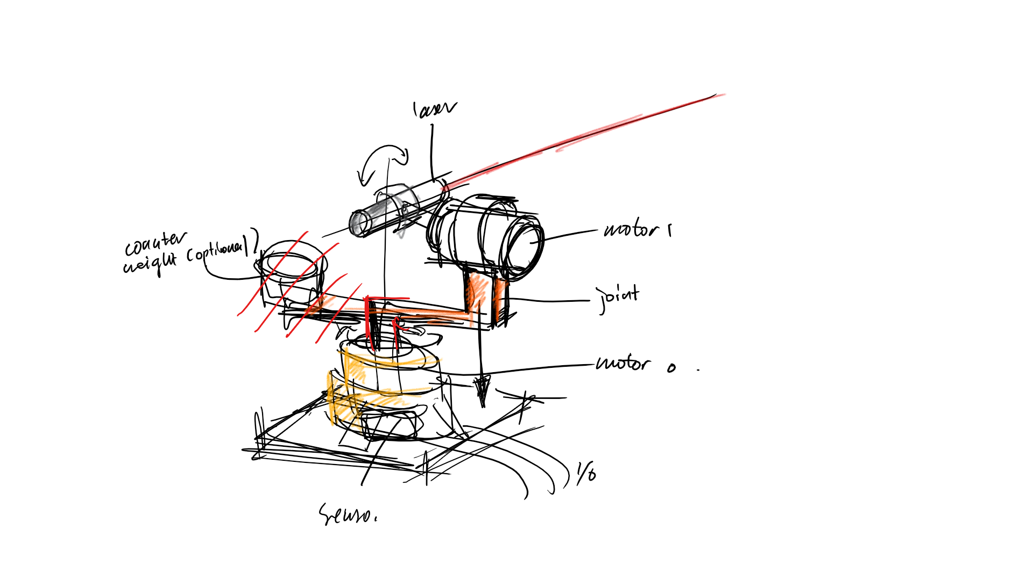
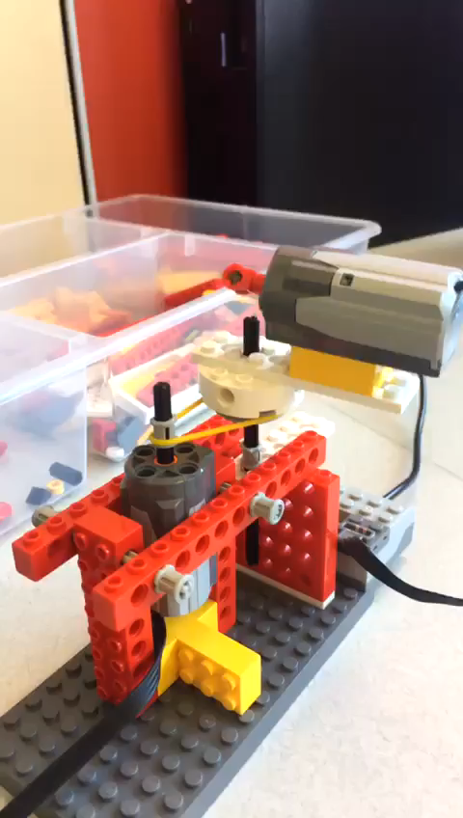
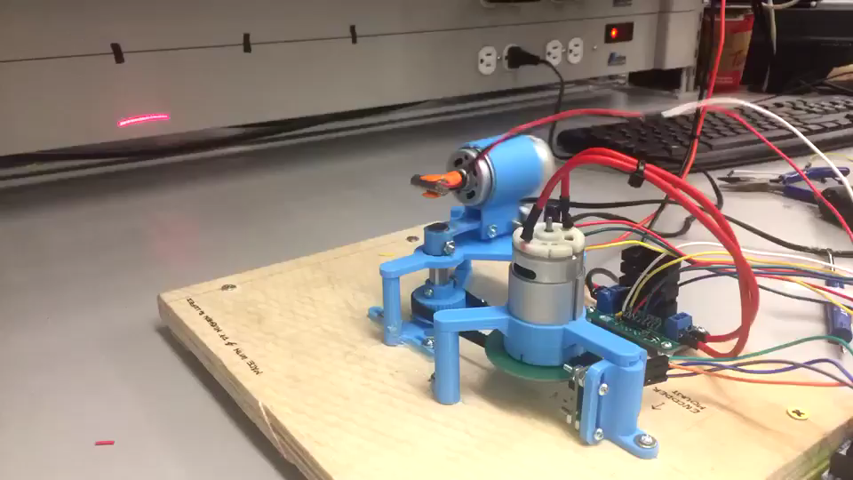
SYSTEM

Slide 17
Controller Logic – Reading Position
State 01
State 11
Increment
State
<A> <B>
Decrement
State 00
State 10

Slide 18
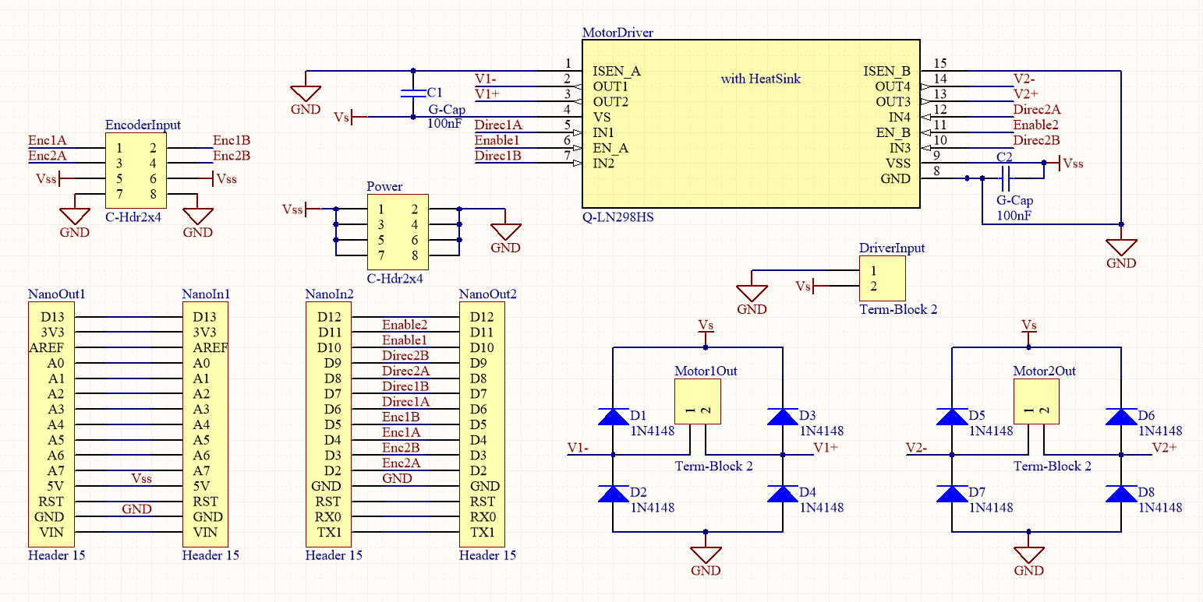
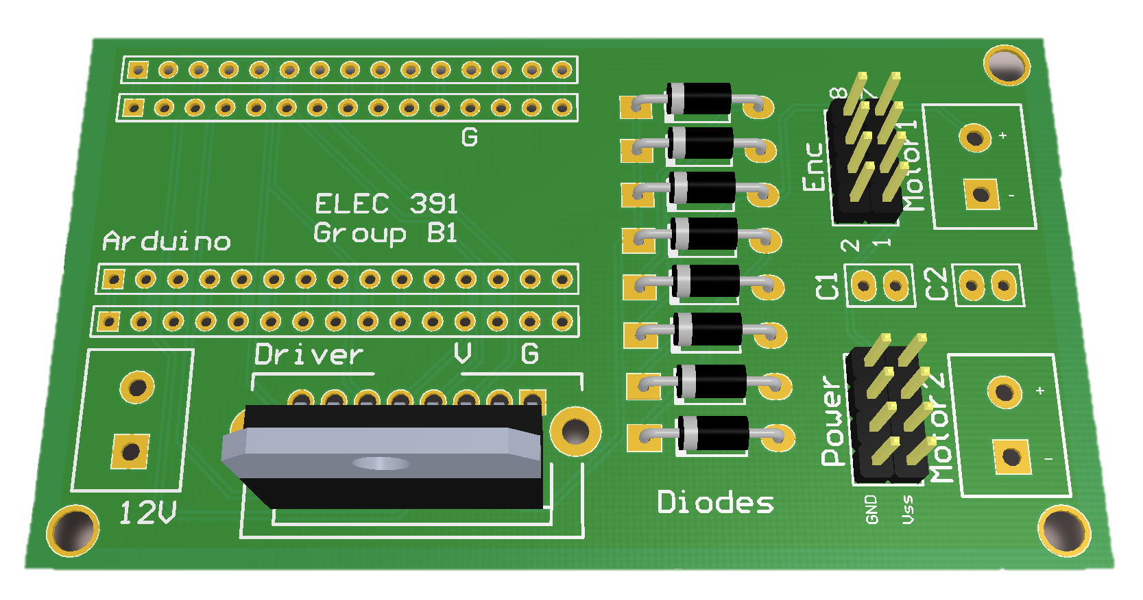
System PCB
Current Driver
Pins from Encoder
Extra 5V Pins
12V Input Pins
Arduino Base
Diode Bridge

Slide 19
Next Steps - Integration
Measure new motor parameters
Adjust system integration design
Improve gear ratios
Retune PIDs

Slide 20



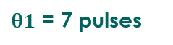
Coordinate Mapping Application
1
2
-0.7, 0.6
0.8, -0.2
3
4
-0.7, 0.6
$$θ1$$
$$θ2$$
0.8, -0.2
$$θ1$$
$θ1$ = 7 pulses

Slide 21
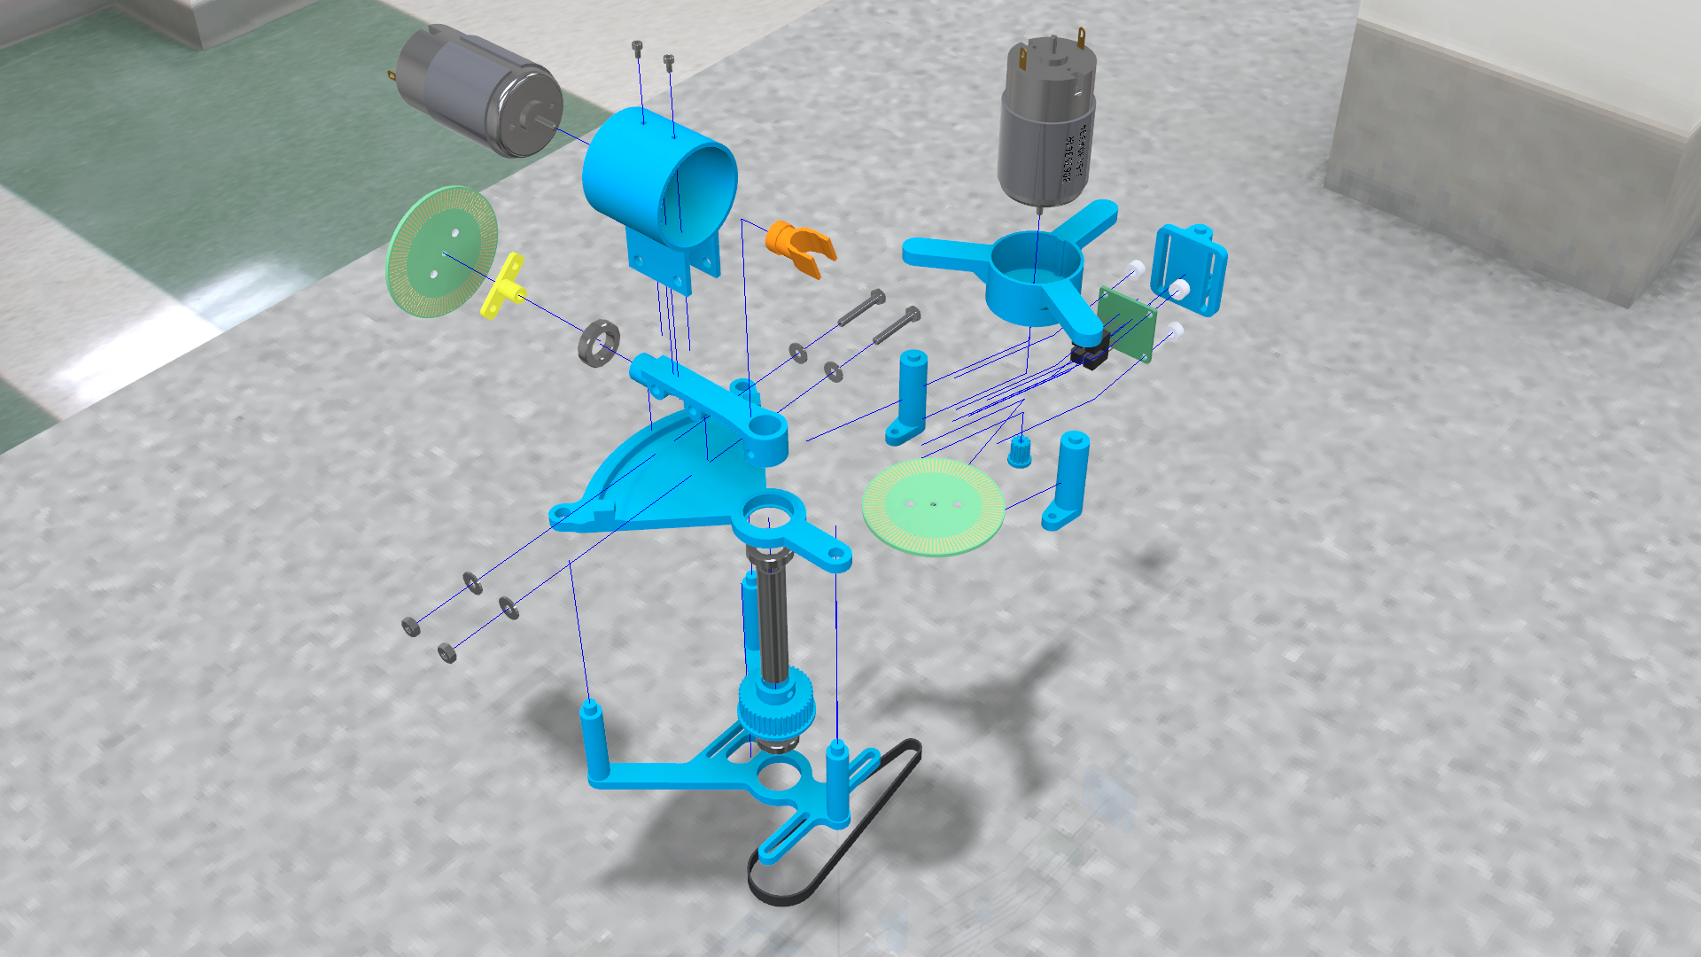
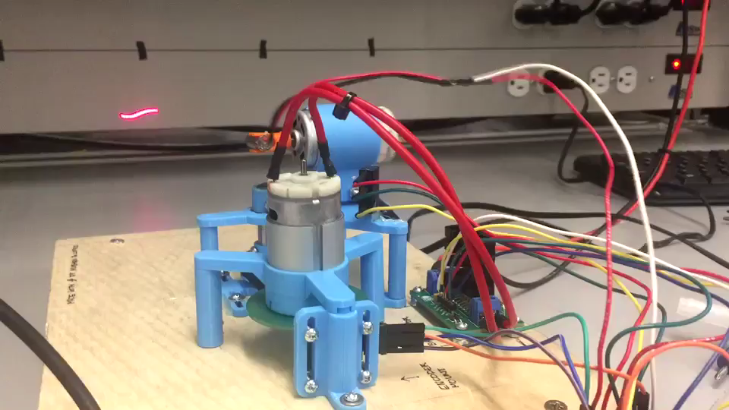
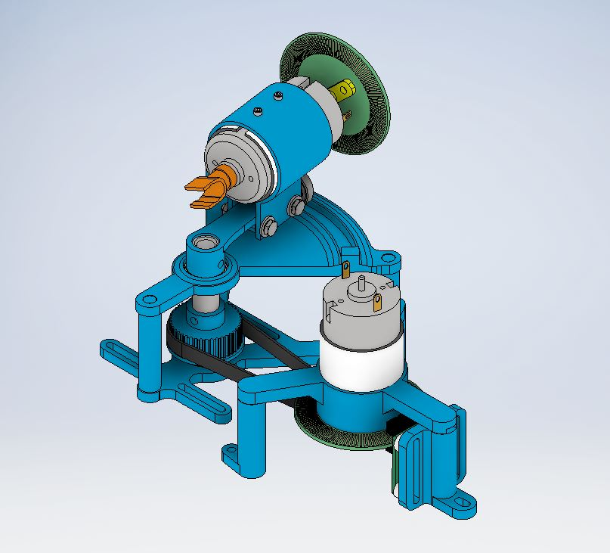
Simulink Model
LIGHT SHOW

Slide 22
Simulink Model

Slide 23
Mapping
1
2
-0.7, 0.6
0.8, -0.2
To Controller
Map desired laser path to list of coordinates
Inverse kinematics are applied to obtain angles
Angles are converted to encoder positions
Time vector is generated based on length of each line segment
3
4
Points:
< n pulses >
Time:
< relative length>
-0.7, 0.6
$$θ1$$
$$θ2$$
0.8, -0.2
$$θ1$$
$θ1$ = 7 pulses

